Slide 1
Exploring Task Independence: Active Learning Approaches in Object Detection vs. Image Recognition
Co-authors: Dr Shabbeer Basha & Sanjana Kulkarni
16th December 2024, at RV University

Slide 2
Introduction
Computer vision has rapidly advanced in object detection and image recognition.
Object Detection: Combines localization and classification of multiple objects within an image.
Image Recognition: Focuses on classifying the overall content of an image.
Active learning allows models to select the most informative samples for labeling, reducing the need for large labeled datasets.
Task independence refers to optimizing object detection and image recognition separately, leading to reduced annotation needs, improved performance, and specialized architectures.

Slide 3
Applications of Active Learning
Medical Imaging:
Efficiently label complex datasets like X-rays, MRIs, or CT scans by prioritizing uncertain samples.
Example: Detecting cancerous regions with limited annotations.
Autonomous Vehicles:
Improve object detection (e.g., pedestrians, traffic signals) with fewer labeled images.
Adapt models to different driving environments (e.g., weather conditions or lighting).
Low-Resource Environments:
Apply active learning to reduce labeling efforts in domains with limited data (e.g., remote sensing or rare wildlife monitoring).
Edge Computing:
Deploy lightweight models trained using task-independent active learning strategies for real-time object detection and recognition.

Slide 4
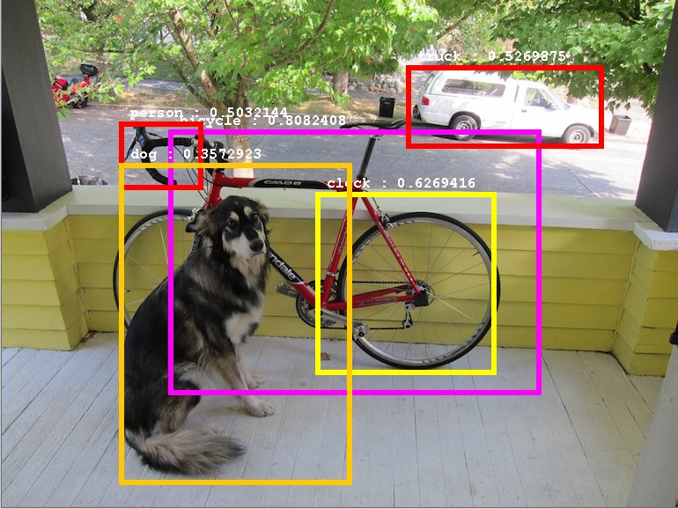
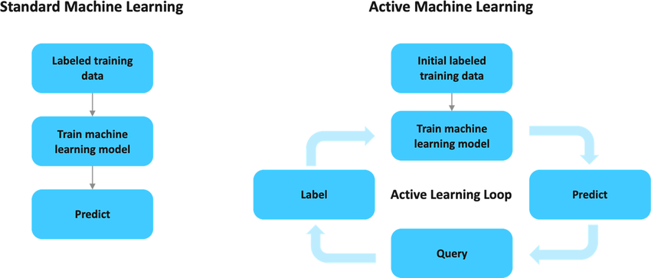
Key concepts
Object Detection: Identifies and localizes multiple objects within an image. Example: Detecting cars, pedestrians, and traffic lights in a scene.
Image Recognition: Classifies the overall content of an image. Example: Categorizing an image as "beach," "cityscape," or "forest."
Active Learning: Allows models to select the most informative samples for labeling, reducing the need for large labeled datasets.
Task Independence: Enables separate optimization of tasks (e.g., detection vs. recognition) to improve efficiency, scalability, and performance.

Slide 5
Active learning strategies
Uncertainty-Based Learning:
Focuses on minimizing labeled samples by selecting the most uncertain data points for labeling. This strategy is especially effective for tasks like object detection, where spatial and categorical accuracy is crucial.
Diversity-Based Learning:
Ensures comprehensive dataset coverage by selecting diverse and representative samples. This is particularly important for tasks like image recognition, which require robust generalization across varied scenarios.
Key Insight:
Both strategies play a vital role in maintaining task independence, enabling models to prioritize the most informative data while optimizing performance for each task.

Slide 6
Research question 1
How do active learning strategies differ between object detection and image recognition?
Object Detection:
Requires identifying and localizing multiple objects in an image.
Relies on uncertainty-based learning for efficient sample selection, reducing labeling efforts.
Image Recognition:
Focuses on overall classification of the image (e.g., labeling as "forest" or "beach").
Benefits from diversity-based learning, ensuring the dataset covers varied scenarios.
Key Difference:
Object detection demands spatial and categorical accuracy, making uncertainty crucial.
Image recognition focuses on broader coverage for robust generalization.
Active Learning
Uncertainty based Learning
Diversity based Learning
Notes:
Why? OD for uncertainity and IR for diversity?
Uncertainty-based methods focus on selecting samples where the model is least confident. This helps refine predictions in areas with high ambiguity (e.g., detecting small or occluded objects).
Diversity-based methods prioritize selecting samples that cover a broad range of features, ensuring that the dataset represents different scenarios (e.g., lighting conditions, backgrounds).

Slide 7
Research question 2
What are the unique challenges in implementing active learning for each task?
Challenges in Object Detection:
Complex Annotations: Requires labeling bounding boxes and categories for multiple objects in an image.
Spatial Context: Needs precise localization and differentiation between overlapping or small objects.
Higher Computational Cost: Training models on multi-object datasets is resource-intensive.
Challenges in Image Recognition:
Generalization: Must classify diverse images with a single label, requiring large datasets.
No Spatial Information: Lacks the need for object localization, making some data less informative.
Domain Shift: Performance drops significantly if training and test data differ (e.g., lighting or perspective changes).

Slide 8
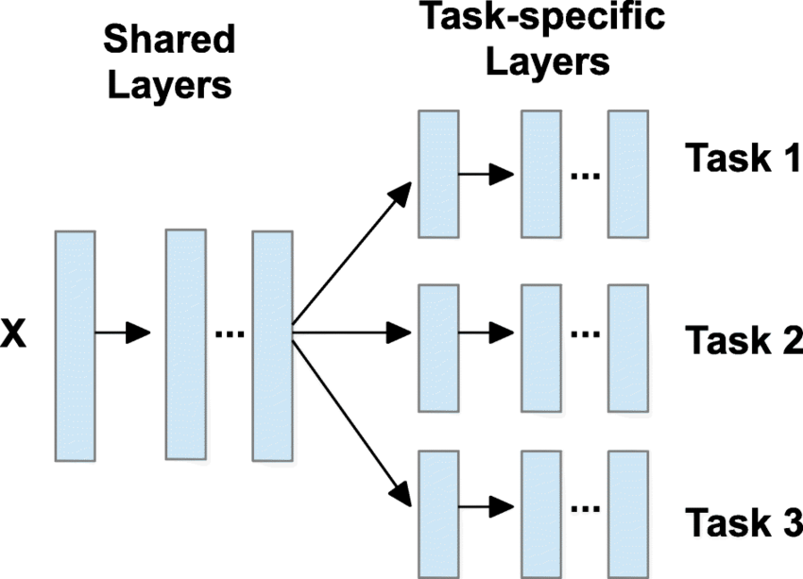
Research question 3
What are the benefits of task independence in active learning?
Reduced Annotation Efforts:
Task-specific active learning strategies (e.g., uncertainty-based for object detection, diversity-based for image recognition) allow models to focus on the most informative samples, reducing the need for exhaustive labeling.
Improved Scalability:
Models optimized independently for object detection and image recognition can scale better to new datasets and tasks.
Adaptation to domain-specific needs becomes more efficient.
Enhanced Performance:
Separating tasks allows for more focused optimization, improving accuracy and robustness.
Task independence enables models to handle specific challenges, such as overlapping objects in detection or domain shifts in recognition.

Slide 9
Experimental setup
Model 1:
Object detection model (e.g., YOLO, Faster R-CNN, SSD) with added image recognition layers (e.g., convolutional or fully connected layers).
Training Process:
First trains for object detection (localization and classification).
Adds image recognition layers for overall image classification.
Uses active learning strategies (uncertainty-based and diversity-based) to optimize performance with minimal labeled data.
Model 2:
Image recognition model (e.g., CNN) with added object detection layers (e.g.,bounding box prediction).
Training Process:
First trains for image classification (overall image label).
Adds object detection layers for localization and detection tasks.
Uses active learning to improve labeling efficiency and task performance.
Comparison Objective:
Evaluate both models on key metrics:
Accuracy
Mean Average Precision (mAP)
Labeling efficiency

Slide 10
Findings and Insights
Active Learning Strategies:
Object Detection: Benefits from uncertainty-based learning to handle spatial and categorical accuracy.
Image Recognition: Benefits from diversity-based learning for robust generalization.
Task Independence:
Enhances efficiency by optimizing tasks separately.
Reduces annotation efforts and improves scalability.
Allows focused optimization, improving accuracy and robustness.
Architectural Trade-offs:
YOLO: Fast but less accurate.
Faster R-CNN: High accuracy but slower.
SSD: Balances speed and accuracy.
Key Insight: Task independence combined with active learning strategies leads to scalable, efficient systems for real-world applications.

Slide 11
Conclusion
Task Independence:
Optimizing object detection and image recognition separately improves efficiency, reduces annotation efforts, and enhances scalability.
Enables focused optimization, resulting in better accuracy and robustness across tasks.
Active Learning:
Strategies like uncertainty-based and diversity-based learning effectively minimize labeled data requirements while maintaining high performance.
Supports efficient training processes for complex tasks in resource-constrained environments.
Architectural Insights:
Trade-offs between speed and accuracy (e.g., YOLO, SSD, Faster R-CNN) highlight the importance of task-specific optimization.
Real-World Impact:
Scalable systems powered by task independence and active learning are transforming applications such as medical imaging, autonomous vehicles, and edge computing.
Future Directions:
Explore transformer-based architectures, improve small object detection, and enhance task consistency in multi-task networks.

Slide 12
Thank you

